Slide 1
The power (and consequences) of technical decisions

Slide 2
@JakeGinnivan
github.com/jakeginnivan

Slide 3
Notes:
The city of Perth in Western Australia was named by Captain James Stirling in 1829 after Perth, Scotland
The West Australian is the second-oldest continuously produced newspaper in Australia, it has been published since 1833 - originally known as The Perth Gazette it became “The West Australian: in 1879(184 years old)
The first edition of The Perth Gazette was printed 4 years later. WA News which is the company I work for is very proud of it’s history.

Slide 5
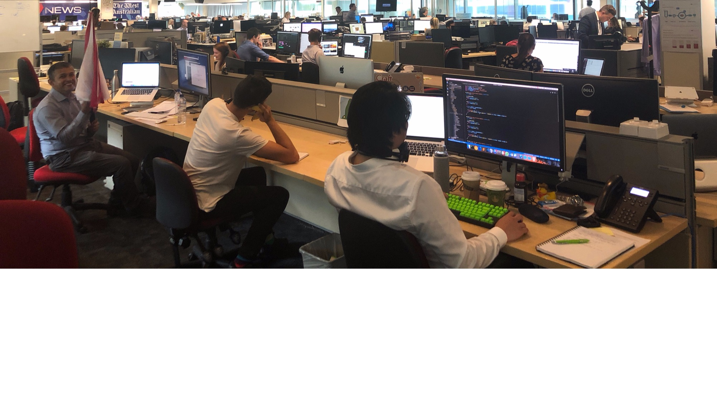

Slide 7
Decisions
Choice of CMS and tech stack
Putting a design system in place
Switching from native swift / java to React Native
Switching from SASS to CSS in JS (specifically Glamorous)
Moving towards continuous deployment

Slide 8
Our team values
Connect with the community (open source, meetups)
Cross functional teams
Autonomy over decisions
Reduce impact to the existing paper business

Slide 9

Notes:
6 months to build a team, and a product end to end. 4 months from starting on the code

Slide 10
What a news site needs
Content Creation
Content Curation
Content Rendering

Slide 11
Newsgate
Notes:
We have a CMS for building the Newspaper, don’t want Journos to have to copy/paste the story, so either we use it as our content editor, or we sync into a secondary system.
Having the ability to see what others have done, and knowing how much synchronisation sucks, you can probably guess which way we went.

Slide 12
Why?
Notes:
Why?
React gaining traction in Perth at the time
New York times had just started rebuilding and open sourcing / blogging about their learnings.. Learn from the best
Wanted to build our team from the community, not recruiters. Allowed us to build an awesome team of amazing and engaged people in ~3 months..
Allowed us to create a component library, and more important a design system which will underpin our design decisions and let us strive for consistency.

Slide 13




?
Notes:
This is not really a technical decision, but everything after this initial core decision has been dramatically impacted.

Slide 14
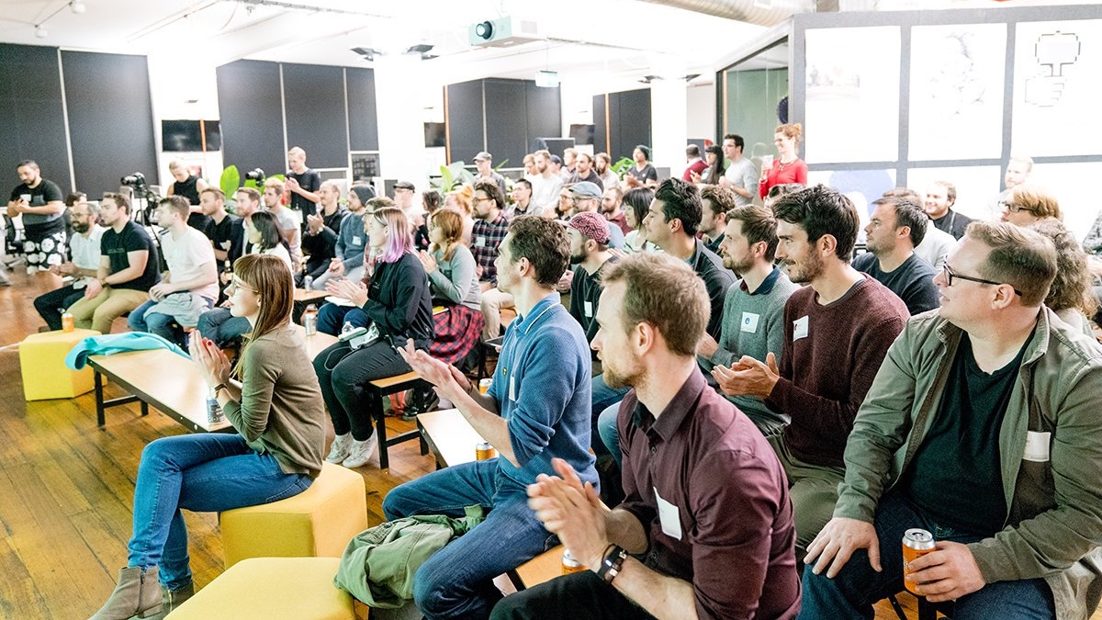

Slide 15

Notes:
Quite popular in Perth at the time,

Slide 16


Slide 17
Learnings

Slide 18
Ad tech / analytics doesn’t work well with single page applications

Slide 19
React has continued to help our team attract and retain awesome people

Slide 20
We had to solve many solved problems

Slide 21
Having JavaScript (TypeScript) everywhere has allowed more team collaboration

Slide 22

Design system vs component library

Slide 23
Component library
Design System
Focus on reusability
Often default styles, expected to be styled in product
For developers
Focus on domain specific language
Does not have to be reusable across products
Focus on underlying consistency from a design point of view across products
For the business and greater team!

Slide 24
Notes:
Design systems bring people together, common building blocks and artifacts to work on together, designers, product owners and developers.

Slide 25
How I (used to) build things
Build in product
Build in another product
Build in component library
Verify works in both products

Slide 26
Design system thinking
Where does this fit?
Build simplest component which achieves goals
Consume in products
Plan & Design
Notes:
All components and UI starts in the component library which for us still we treat as an infant design system. We use common margins, font systems, have a set available colours, have a styleguide page which shows intended usage of the component with sample data.
Focus on intended usage, not adaptability. The goal is to create building blocks which conform to the brand and will fit into all our products.

Slide 27
Design systems do not stop us creating reusable modules
But not all modules need to be exposed to the design system
Notes:
Dark blue is a design system component,

Slide 28
Notes:
Just make sure you don’t separate component development from delivering features, otherwise you might separate your developers from one another, get some who build the components and some who build the APIs and integrate them into the products.
It was suggested many times to split the team into a component library team then product team, don’t do this

Slide 29
Develop component
Install / test integration in product
Setup API, release
Publish pre-release npm package

Slide 30
Learnings

Slide 31
Ensure you have a shared understanding of the goal of a decision/initiative/project

Slide 32
Front-end development is hard, a design system is like an architecture plan for your UI / UX

Slide 33
Not planning is planning to fail
Notes:
A few times we tackled problems in the product, mainly because we didn’t understand it.

Slide 34
Visual regression testing is awesome,
invest in good testing tools
Notes:
A few times we tackled problems in the product, mainly because we didn’t understand it.

Slide 35
Document your decisions, it saves repeated conversations

Slide 36


Slide 37
Notes:
We had a single mobile developer, separated from the team

Slide 41
Learnings

Slide 42
Multiple platform release and code sharing works!

Slide 43
Just because there is a common language to work in, doesn’t mean everyone should…

Slide 44
Just because there is a common language to work in, doesn’t mean everyone should…

Slide 45
It has a cost, like every abstraction

Slide 46
Throwing a team at a deadline is always a bad idea

Slide 47
Styles in JavaScript meant more developers got involved in styling conversations

Slide 49
Notes:
Typical developer thinking. I need styles
Bootstrap!

Slide 50
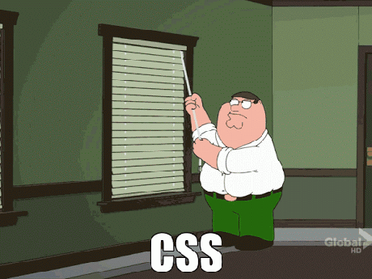
Notes:
Because we all know that

Slide 51
export const NavStyled = glamorous.nav({
fontSize: calcRem(13),
position: 'absolute',
overflow: 'hidden',
width: calcRem(240),
height: 'auto',
outline: 0,
fontFamily: fonts.designSystem.heading
})

Slide 52
Learnings

Slide 53
CSS is JS increased engagement in styling related work!

Slide 54
The conceptual alignments has reduced issues

Slide 55
CSS being treated as a concept, not a language

Slide 56
Continuous Deployment

Slide 57
Notes:
We started off with

Slide 58
Predictability
Timeboxes
Commitments
Creating shippable increments
Notes:
Over the past year, my opinion on scrum has changed. My thoughts were, if your team can’t do scrum, they are lacking the discipline to just meet a commitment.
But sticking to the timebox helps the team, but can hurt the business.

Slide 59
Notes:
Back to goals, our team is trying to replace these sites, and we have much more we want to do, than what we can achieve.

Slide 63
Learnings

Slide 64
When things are busy, finishing tasks becomes hard

Slide 65
Look into why something is not working for you, and change it

Slide 66
Accountability is a powerful tool

Slide 67
Honorable mentions

Slide 68
Switching from elastic search to PostgreSQL before launch
Switching to TypeScript across the board

Slide 69
Key takeaways

Slide 70
Make decisions, they can be changed
Non-decisions often cost more then a wrong one

Slide 71
Consider the impacts and benefits to the team,
not just the technology itself

Slide 72
People make you succeed, not the technology choices.
A good team will make anything work

Slide 73
The power (and consequences) of technical decisions
Jake Ginnivan

